Slide 1
HomeoStasis is keeping the inside of the body constantly the same. The brain does this by responding to NEGATIVE FEEDBACK:
Negative message: All is not correct here!
Response: Put in the opposite of what is there.
In this way, the brain controls the body’s levels of glucose, water, carbon dioxide, salt, etc.
It is SO simple! See pages 64-65 for examples. Apply!

Slide 2
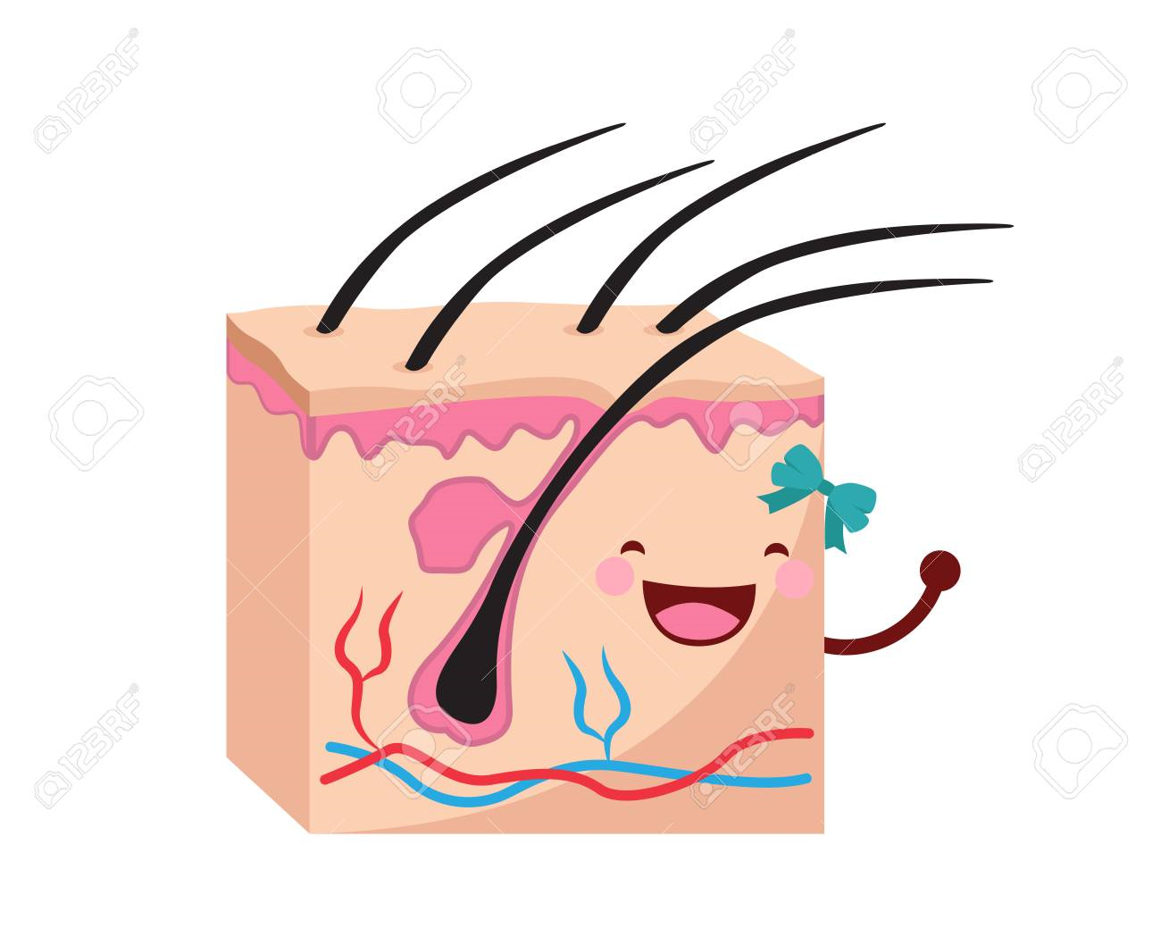
SKIN STRUCTURE
The lower layer is called the Dermis. It is made of connective tissue. Inside it are: Pressure, Blood Vessels, Sweat Glands, and Hair follicles (with Erector Muscles & Sebaceous Glands). Note functions of each on page 67.
The upper layer is called the EpiDermis. It has the Horny Layer of dead cells to water-proof, tough Non-Granular Layer, protective Granular Layer, Malpighian Layer with pigment (colour). Also Receptors of pain and touch. Also note functions of each on page 67.

Slide 3
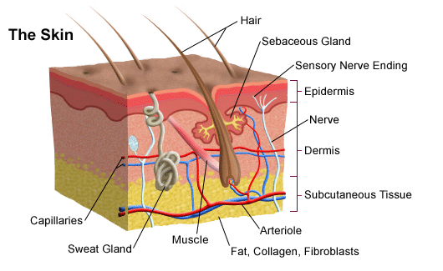

Slide 4
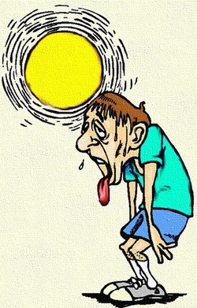
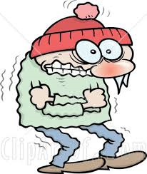
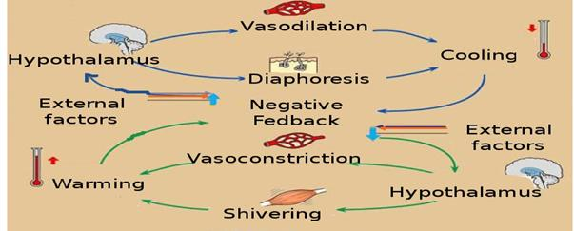
THERMO-REGULATION
Our body temperature remains the same, thanks to Negative Feedback from the skin:
ThermoReceptors tell the brain that we are above 37°C.
The brain tells the HypoThalamus, which reacts:
It tells the blood vessels to get wider (VasoDilation) for more blood (to bring heat for release).
It tells Erector Muscles to relax, so hairs lie flat and let heat out.
Sweat glands release sweat for evaporation.
If BELOW 37°C, the OPPOSITE processes will occur.

